Slide 1

MICROSOFT DATA CHALLENGE
PRESENTED BY
CYNTHIA CHIURI

Slide 2

PROBLEM STATEMENT
Microsoft sees many big companies creating original video content and want to establish their own movie studio to compete within the digital content market.
To assist Microsoft in solving this problem, I will consider:
How many movies are being made of each genre?
What genres are the most successful, both in terms of audience rating and gross earnings?
How correlated is the Return on Investment to the Genres ratings ?

Slide 3
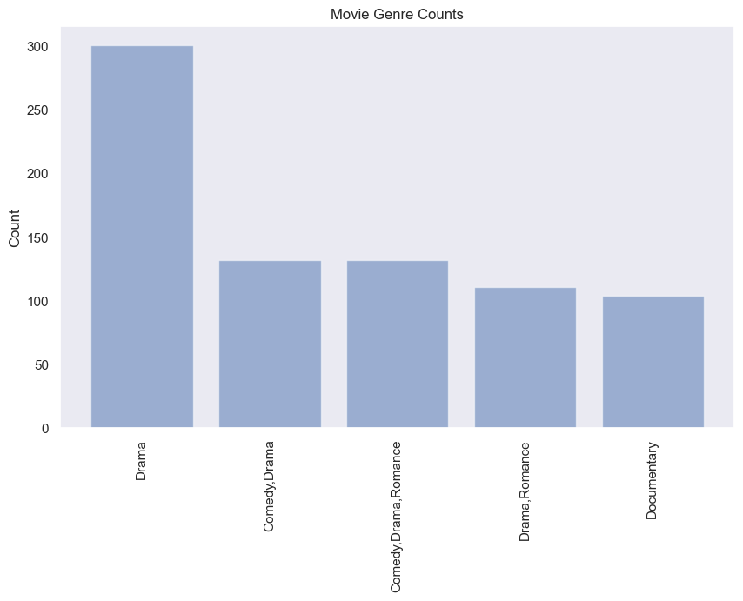
Hierarchical genres From the data it was evident that Drama had the highest count. Followed closely by Comedy, Drama.

Slide 4
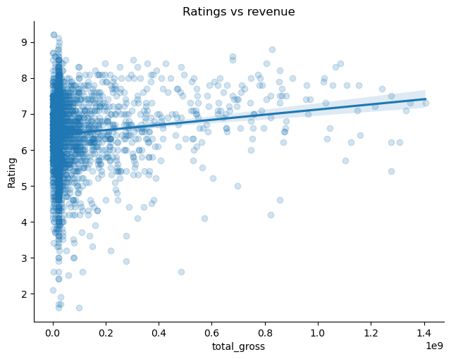
EFFECT OF TOTAL REVENUE IN RATING Positive total gross impacts positively on ratings.

Slide 5
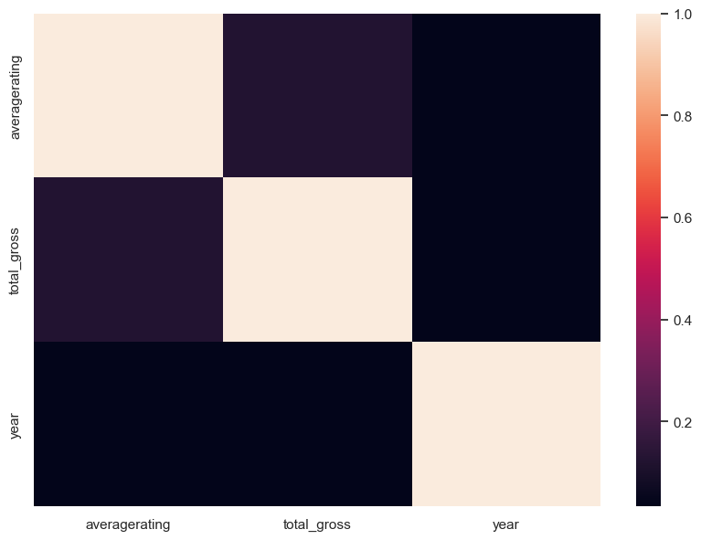
HEAT MAP TO SHOW CORRELATION Average rating is weakly correlated to the total gross return on Investment.

Slide 6
RECOMMENDATIONS
We have drawn many interesting inferences from the dataset, here's a summary of the few of them:
The most genre type is drama with the least as war,
The amount of total Gross does affect the rating of the movie,
Some Genre Combinations are more relatable to each other unlike others.
We therefore recommend:
The studios that should be invested in should be either The Mayor, Tomorrow or The way
The company should consider starting with the production of drama genre movies.

Slide 7


